Slide 1
UMSoM COVID Updates
January 2022

Slide 2
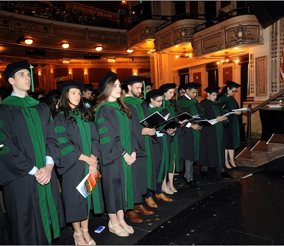
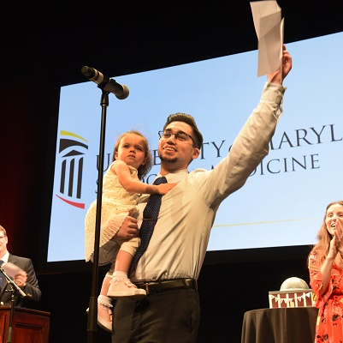
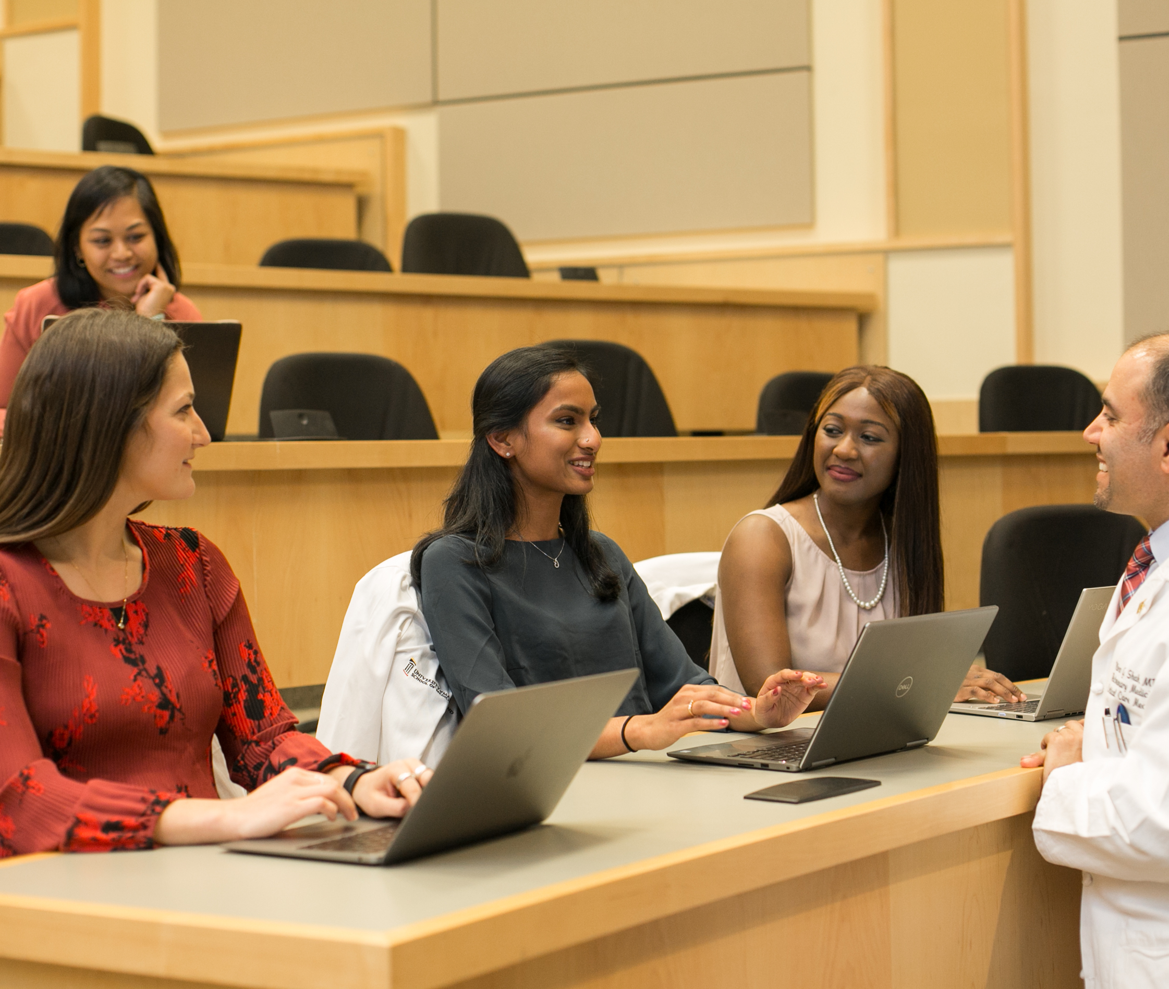
The Goal!

Slide 3
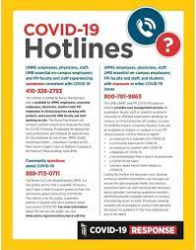
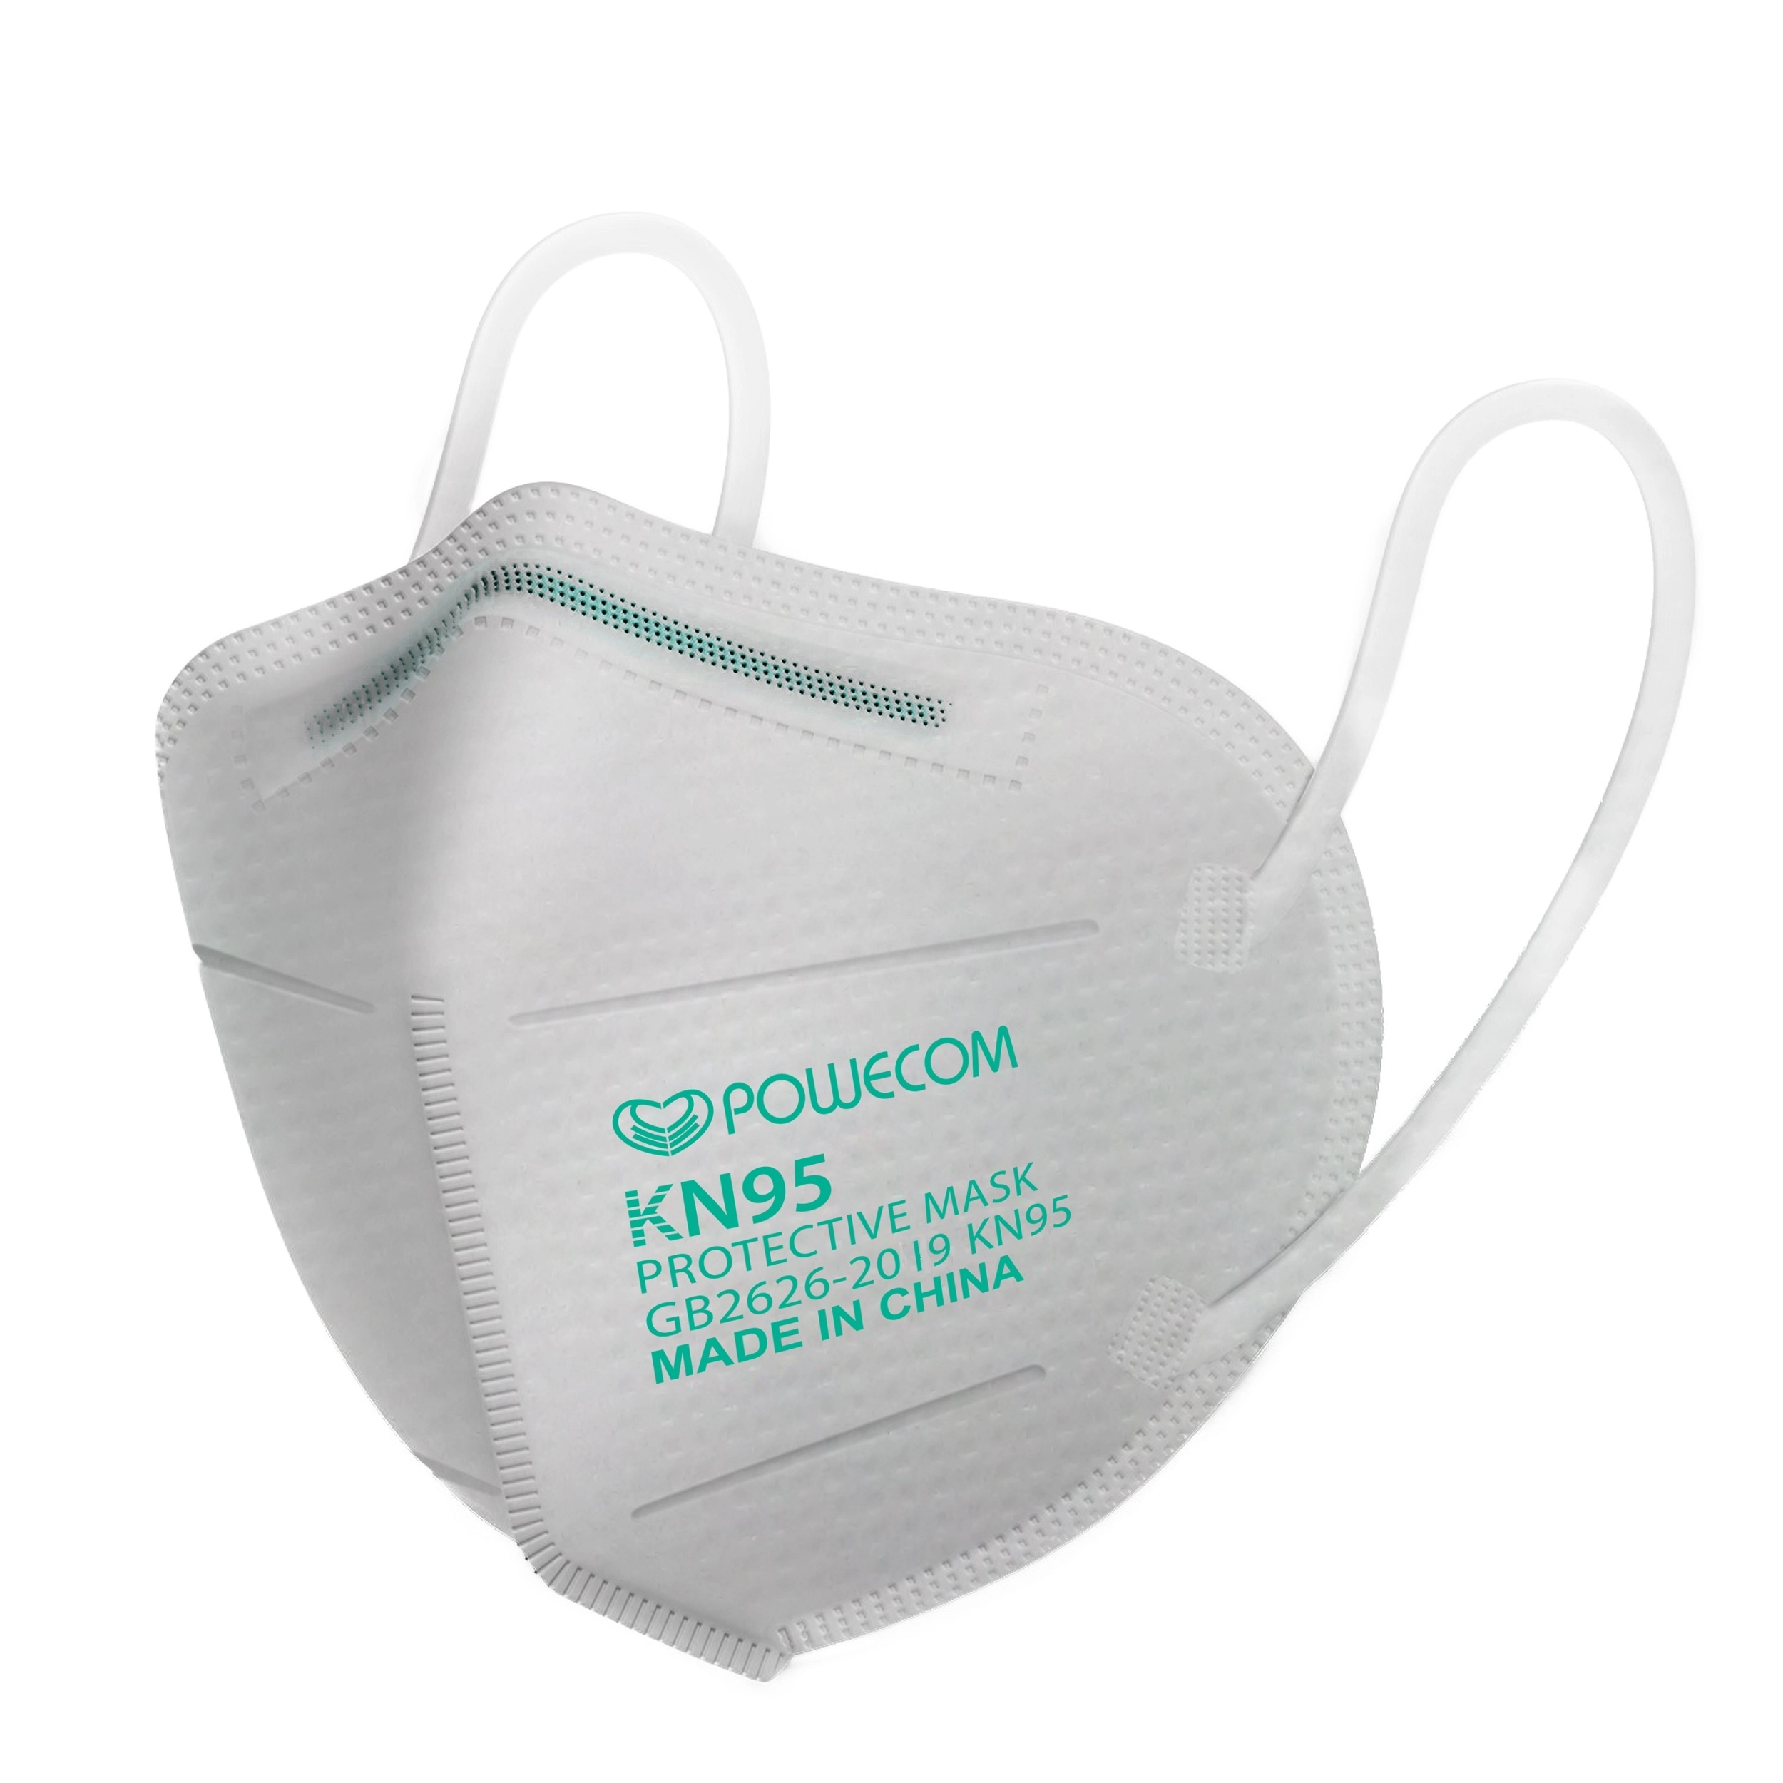
What you can do
Masks On
Get Boosted
Go Home, Stay Home if sick or exposed
COVID-19 Management Portal
UMB COVID-19 Management Portal
https://www.umaryland.edu/coronavirus/

Slide 4
Housekeeping issues
Document clinical shadowing experiences for contact tracing
Request approval for travel to scientific conferences under COVID
**This is NOT to be used for Conference Reimbursements
Approvals for meetings, gatherings, events
Notes:
Shadowing: As a reminder, all shadowing experiences must be documented; you should use this FORM to document shadowing for a one-month time span with one preceptor, but will need to complete the form again monthly for new or ongoing experiences. It is essential that you document appropriately so that you can be included in contact tracing efforts in the event of a COVID exposure.

Slide 5
Housekeeping issues
Document clinical shadowing experiences for contact tracing
Request approval for travel to scientific conferences
Approvals for meetings, gatherings, events
Indoor gatherings and meetings | Up to 25 people; larger size meetings require OSA Approval
Outdoor gatherings and meetings | Up to 250 people; larger size meetings require OSA Approval
Events exceeding 25 visitors in attendance | Requires OSA Approval
https://www.umaryland.edu/coronavirus/students-and-postdocs/event-services-and-dining/
Notes:
Shadowing: As a reminder, all shadowing experiences must be documented; you should use this FORM to document shadowing for a one-month time span with one preceptor, but will need to complete the form again monthly for new or ongoing experiences. It is essential that you document appropriately so that you can be included in contact tracing efforts in the event of a COVID exposure.

Slide 6
What you can do
Masks On
Get Boosted
Go Home, Stay Home if sick or exposed
COVID-19 Management Portal
UMB COVID-19 Management Portal
https://www.umaryland.edu/coronavirus/

Slide 7
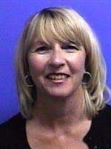
If you have an high-risk exposure, symptoms or +COVID test
Go home or stay home
Complete the UMB COVID-19 Report Form and follow the self-directed guidance
*This will provide initial advice and guidance based on your scenario
*If you have additional questions, you can …
Contact the UMSoM Medical Student COVID Support Resource
Call the UMB COVID Hotline 800-701-9863
Go to Student Health
UMSoM COVID Support Resource
Joan Hebden, RN, MS, CIC
jhebden@som.umaryland.edu
*Note, expected response time to inquiries is within 24 hours M-F

Slide 8
What is a high-risk exposure?
Close Contact/High-Risk Exposure
The person you were in contact with has COVID-19, was not wearing a mask, and you:
Were 6 feet or less away from each other
Were in contact for a total of 15 minutes over 24 hours (doesn’t have to be consecutively)
Did not wear a KN95 mask or N95 respirator

Slide 9
Symptoms
Sore or scratchy throat
Fever or chills
Cough
Shortness of breath or difficulty breathing
Fatigue
Muscle or body aches
Headache
New loss of taste or smell
Congestion or runny nose
Nausea or vomiting
Diarrhea

Slide 10
I am an M1/M2 and would like to attend class remotely …
Complete the UMSOM MD Program Virtual Learning Accommodations Request located on the COVID-19 Resource tab on MedScope
Then simply log on and learn!
Only one request needed per isolation/quarantine period
Contact CSS team to trouble shoot zoom/connectivity
Contact OME (Ms. Reynolds/Roth) for attendance questions
Contact PoM Course Director and Preceptor directly to discuss missed time
Note: to receive credit for participation you must complete the form before the start of the session

Slide 11
Not feeling up to remote participation?
That is OK! Your health/safety are the priority. We all need a day off sometimes, and the ability to take days as you need is built into the attendance policy.
If you need to miss more than 2 sessions, please connect with an OSA faculty member so we can assist with academic support as needed.

Slide 12
I am an M1/M2 and I am ready to return to in-person learning after isolation/quarantine
Great! Welcome Back
When you initially complete the Virtual Learning Accommodations Request, you will be sent an email with a follow up link; you will use this to mark your return based on following the UMB COVID guidance
Before you return you should have followed the advice provided, be asymptotic (or improving), have a negative test if one was required

Slide 13
I am an M3/M4, what do I need to do?
Go home or stay home
Complete the UMB COVID-19 Report Form and follow the self-directed guidance
Loop in ALL of the following immediately
Course Director
Clinical Team/Attending
OSA
When you are ready to return (post isolation/quarantine), complete the M3/M4 Return to Clinical Site Attestation Form located on MedScope

Slide 14
Oh no, I have an exam, assessment, shelf …
That’s OK! We can help …
If you are feeling well enough to take the assessment as scheduled and it is > 24 hours until the scheduled assessment, complete the Request for Remote Assessment Form located on MedScope.
If it is within 24 hours of the scheduled assessment, you should also directly email ALL of the following: Dr. Thom, Dr. Lacap, Ursula Goldman, Paul Moore
If you would like to request an extension and take the assessment at a later date, please reach out to any OSA faculty member to discuss

Slide 15
What you can do
Masks On
Get Boosted
Go Home, Stay Home if sick or exposed
COVID-19 Management Portal
UMB COVID-19 Management Portal
https://www.umaryland.edu/coronavirus/

Slide 16
Testing
Now widely available
Find a COVID test near you
https://coronavirus.maryland.gov/pages/symptoms-testing
Nomi Health - offering rapid antigen testing and PCR tests by appointment- 419 W Baltimore St next to Panera
BCCC services now at the State Center complex - need to schedule
In many cases, rapid (at-home) Antigen testing is OK
CovidTests.gov
OSA/OME have some tests
UMMS/clinical site have tests

